Slide 1
INTRODUCTION TO MYSQL DATABASE

Slide 2
Introduction
A database is a structured collection of records or data stored in a computer system and organized in such a way that it can be quickly searched and information can be rapidly retrieved.
The Structured Query Language, SQL is loosely based on English and also used in other databases

Slide 3
Summary of Database Terms
The main terms you need to acquaint yourself with for now are as follows:
Database
  The overall container for a collection of MySQL data
Table
  A subcontainer within a database that stores the actual data
Row
  A single record within a table, which may contain several fields
Column
  The name of a field within a row

Slide 4
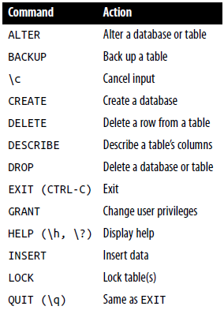
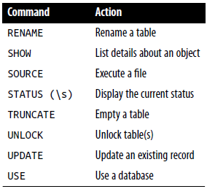
MySQL Commands

Slide 5
Database set up
CREATE DATABASE publications;
USE publications;
Creating a database
Creating users
Creating a table
Renaming a table
Adding a new column
Removing a column
Deleting a table
GRANT PRIVILEGES ON database.object TO 'username'@'hostname‘ IDENTIFIED BY 'password';
[or for admin] GRANT ALL ON publications.* TO 'jim'@'localhost‘ IDENTIFIED BY 'mypasswd';
CREATE TABLE classics (
author VARCHAR(128),
title VARCHAR(128),
type VARCHAR(16),
year CHAR(4)) ENGINE MyISAM;
ALTER TABLE classics RENAME pre1900;
ALTER TABLE classics ADD pages SMALLINT UNSIGNED;
ALTER TABLE classics DROP pages;
DROP TABLE classics ;

Slide 6
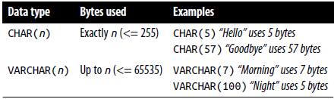
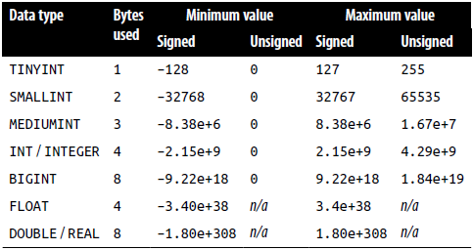
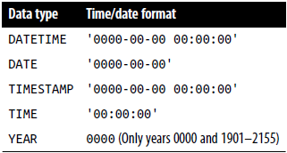
Data Types
The CHAR data type
The Binary Large Object (BLOB) data type is used for storing binary data such as pictures
Numeric data types
DATE and TIME

Slide 7

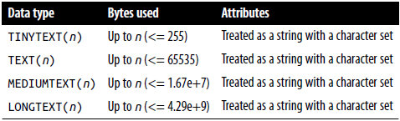
Data Types
The AUTO_INCREMENT data type ensures that every row in your database is guaranteed to be unique
The BINARY data type
The TEXT and VARCHAR data types
VARCHAR is the better and faster data type to use compared to text
ALTER TABLE classics ADD id INT UNSIGNED NOT NULL AUTO_INCREMENT KEY;

Slide 8
Data Manipulation Language
Adding data to a table
Querying a MySQL Database : SELECT
Querying a MySQL Database : DELETE
Querying a MySQL Database : UPDATE
INSERT INTO classics(author, title, type, year)
VALUES('Mark Twain','The Adventures of Tom Sawyer','Fiction','1876');
SELECT author,title FROM classics;
SELECT COUNT(*) FROM classics;
SELECT DISTINCT author FROM classics;
SELECT author,title FROM classics WHERE isbn="9781598184891 ";
SELECT author,title FROM classics WHERE title LIKE "%Species";
SELECT author,title FROM classics LIMIT 1,2; //return 2 rows starting from row 1
SELECT author,title FROM classics ORDER BY title DESC;
DELETE FROM classics WHERE title='Little Dorrit';
UPDATE cats SET name='Charlie' WHERE name='Charly'";

Slide 9
Accessing MySQL via phpMyAdmin
XAMPP provides Web-based application to administer MySQL database
the lefthand pane of the main phpMyAdmin screen is where you select any database
From here you can perform all the main operations, such as creating new databases, adding tables, creating indexes, and much more
http://localhost/xampp

Slide 10
Connecting to a MySQL Database
Connect to database
<?php
define('DB_USER','root');
define('DB_PASSWORD','');
define('DB_HOST','localhost');
define('DB_NAME','aliff');
$dbc = mysqli_connect(DB_HOST,DB_USER,DB_PASSWORD, DB_NAME);
if (!dbc) {
echo "Failed to connect to MySQL: " . mysqli_connect_error();
}
?>

Slide 11
Creating data into a table
In the example below, we populate values submitted via a form into local variables
mysqli_real_escape_string ensures the posted variable is safe for the database
It accepts two parameters (connection and the data to be checked) to function
<?php
$id=$_POST["id"];
$nama=mysqli_real_escape_string($dbc,$_POST["nama"]);
$pword=$_POST["pword"];
$role=$_POST["role"];
$q="insert into staff values($id,'$nama',$role,'$pword')";
$res=mysqli_query($dbc,$q);
?>

Slide 12
Retrieving data from table
Using a separate variable for the query helps identify errors
mysqli_query function accepts two parameters (connection and query) and executes the query
mysqli_fetch_array function will fetch results in an array for you to display
<?php
$q="select * from staff where role <> 1";
$res=mysqli_query($dbc,$q);
while($row = mysqli_fetch_array($res))
echo $row["id"] ." ".$row["nama"]." ".$row["baki"];
mysqli_free_result($res);
?>

Slide 13
Updating data in table
Use the UPDATE query to change the content of data in a table
Works similar to SELECT
The code below checks if query is successful or displays error message accordingly
<?php
$q="update staff set pword='$pword' where id='$uname'";
$res=mysqli_query($dbc,$q);
if (!res)
echo("Error description: " . mysqli_error($dbc));
?>

Slide 14
Deleting data from a table
Use the DELETE query to remove a data from a table
The code below checks if query is successful or displays error message accordingly
<?php
$q=“delete from staff where id='$uname'";
$res=mysqli_query($dbc,$q);
if (!res)
echo("Error description: " . mysqli_error($dbc));
?>

